Slide 1
GIS Lesson 5
Introduction to Raster Data
柵格數據簡介
2020/6/3

Slide 2
Agenda
1. Introduction to Raster Data 柵格數據簡介
A. What is Raster Data? 甚麼是柵格數據？
Definitions 定義
Examples 例子
B. How to Visualize and Process Raster Data? 如何顯示和處理柵格數據?
Raster Generalization (柵格概括法)
Map Algebra (地圖代數)
2. Tutorial 個別指導
Find and download raster data from an open-source data portal (e.g. https://www.naturalearthdata.com/downloads/10m-raster-data/10m-natural-earth-1/)
Explore the raster dataset in QGIS

Slide 3
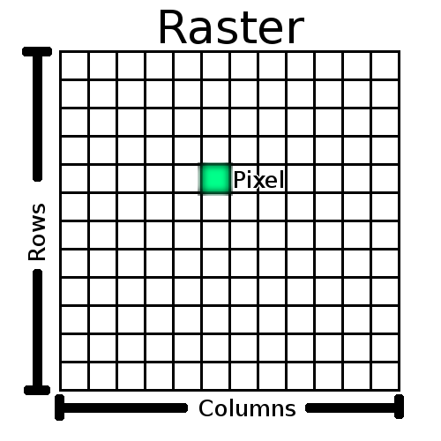
A. What is Raster Data? 甚麼是柵格數據？
Cell size
Ras-ter
Resolution (解像度)= Number of Rows * Number of Columns
What is the resolution of this raster?
Notes:
Picture Source: https://docs.qgis.org/testing/en/docs/gentle_gis_introduction/raster_data.html

Slide 4
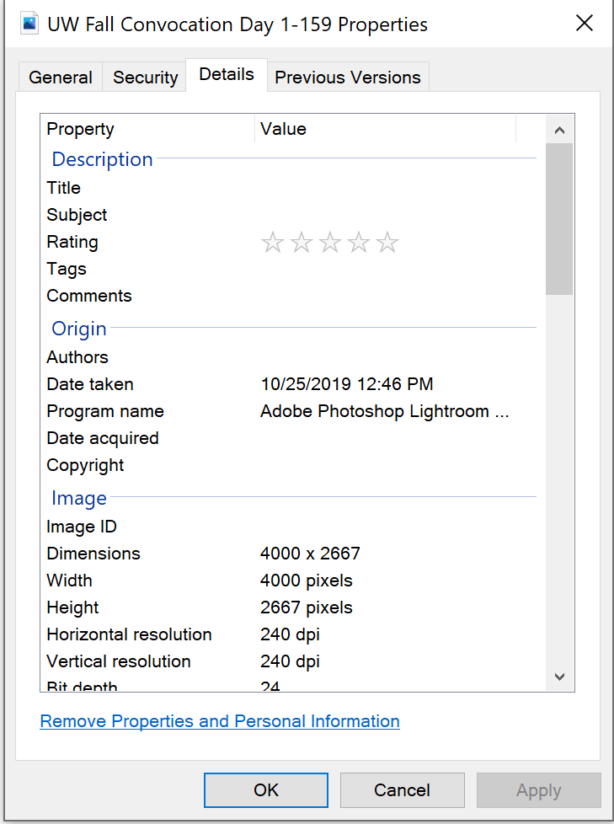


Quick example – not GIS … but familiar faces hahaha ☺
Resolution = 4000 * 2667 = 10,668,000 pixels

Slide 5
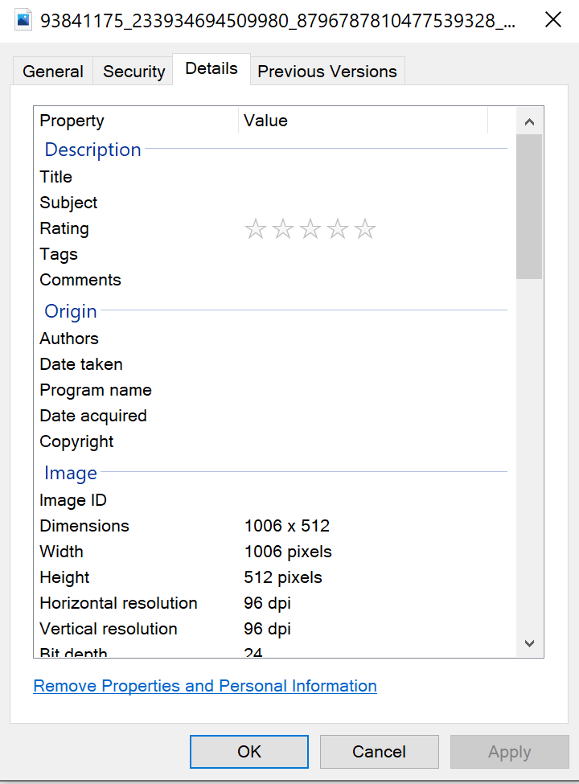


Another example …
Can you see the difference of the two pictures?
Resolution = 1006 * 512 = 515,072 pixels

Slide 6
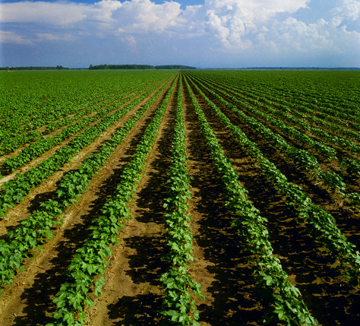
Raster data is like a field…
Notes:
Source: GEOG 187 Lecture 06 Slide 4

Slide 7
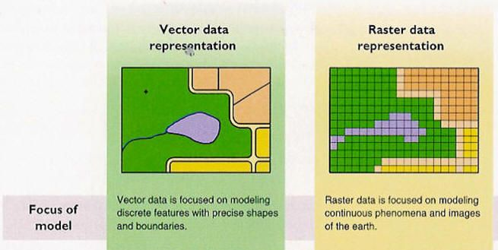
Definition of Raster Data 柵格數據的定義
Raster data:
Is made up of pixels (像素) (aka grid cells) (same-size pixels in each raster)
Is used to display continuous (連續的) information (e.g. elevation, temperature etc.)
Examples
A topographic map showing the elevation changes in Waterloo Region
Satellite images or aerial photos of the Earth for remote sensing
Scanned maps or drawings and building photos
Satellite basemaps on QGIS
Land use/land cover maps
Digital Elevation Model (DEM)
2
3
1
4
5
8
6
7
9
Discrete (離散的): clearly separate data; different objects can be separated; each object has the same value (e.g. the green polygon can be separated from other polygons)
Continuous (連續的): data can take any value within a range (e.g. any values between 0 and 100); each grid can have different values
Notes:
Source:
1.https://www.google.com/url?sa=i&url=https%3A%2F%2Fwww.pinterest.com%2Fpin%2F409827634827051028%2F&psig=AOvVaw360G8Ds9x3wm5G-6cgQ-es&ust=1591122812522000&source=images&cd=vfe&ved=0CAMQjB1qFwoTCLCRg8eg4ekCFQAAAAAdAAAAABAP
2. https://desktop.arcgis.com/en/arcmap/10.3/manage-data/raster-and-images/what-is-raster-data.htm
3. https://desktop.arcgis.com/en/arcmap/10.3/manage-data/raster-and-images/what-is-raster-data.htm

Slide 8
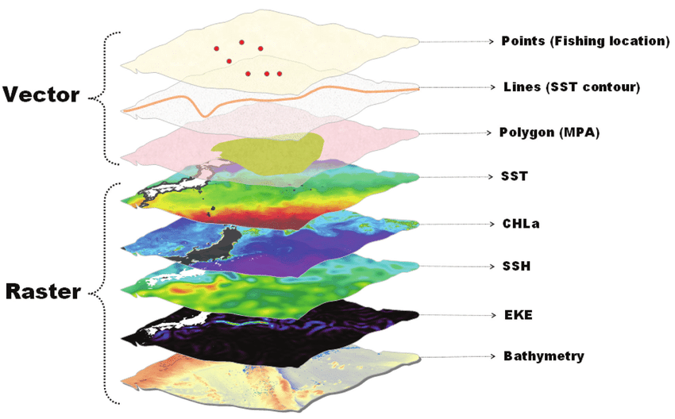
Vector vs Raster
Notes:
Source: https://www.researchgate.net/figure/A-graphic-representation-of-the-core-GIS-data-types-vector-point-line-and-polygon-and_fig2_255850776

Slide 9
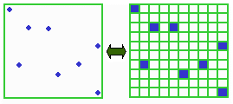
Vector to Raster?
Points
Pixels
Notes:
Source: GEOG 187 Fall 2015 Lecture 06 Slide 10

Slide 10
NoData cells
NoData cells: cells that do not have any data value (沒有數據值的柵格)
Can enhance contrast (可以加強對比)
Notes:
Source: GEOG 187 Fall 2015 Lecture 06 Slide 13

Slide 11
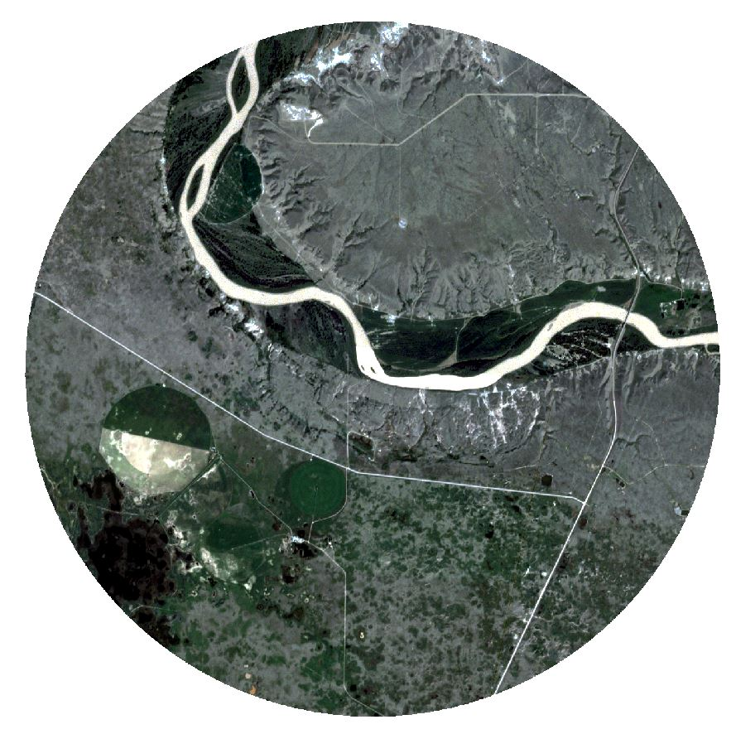
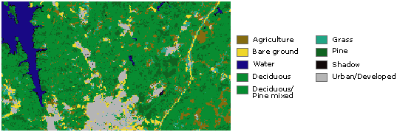
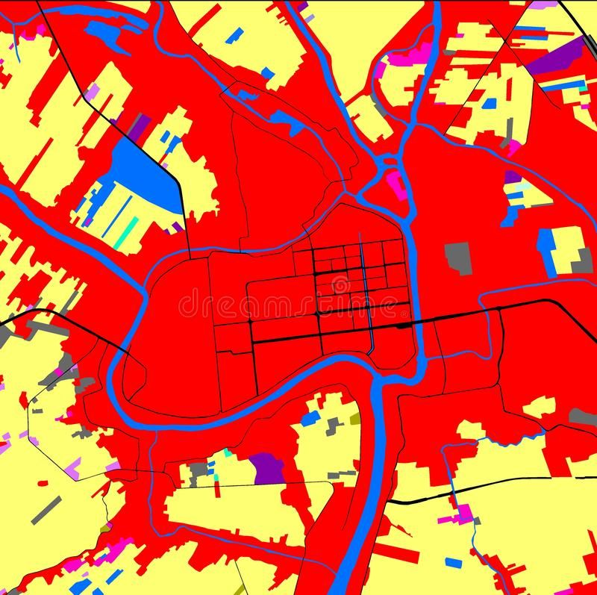

Quick Check…
Which of the following is NOT an example of raster data?
A. B.
C. D.
Notes:
Source: https://www.google.com/url?sa=i&url=https%3A%2F%2Fwww.photoblog.com%2Flearn%2Fhow-to-take-good-architectural-photography%2F&psig=AOvVaw0bqs1xIPdaIPYIAg9hR_kC&ust=1591124029509000&source=images&cd=vfe&ved=0CAMQjB1qFwoTCKjVmYml4ekCFQAAAAAdAAAAABAJ

Slide 12
B. How to Visualize and Process Raster Data? 如何顯示和處理柵格數據?

Slide 13
Raster Generalization (柵格概括法)
Used when a high-resolution image is shown in a lower resolution
Each pixel (cell) could only have one value
Largest share rule
Central point rule
^^^ Used most of the time
^^ Used in some cases, such as showing temperature
Notes:
Assume there is a picture and you have limited resolution (i.e. you are reducing the spatial resolution), then you need to use raster generization.
Source: GEOG 187 Fall 2015 Lecture 06 Slide 18

Slide 14
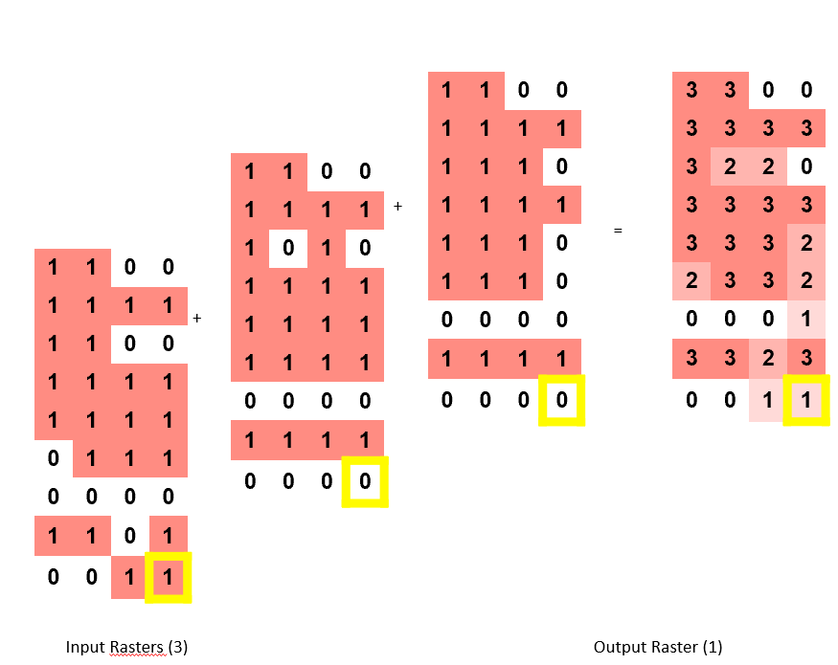
Map Algebra (地圖代數)
Language for merging raster layers with the same size and resolution (一種用以合併同一大小和解像度的電腦語言)
Can be used with:
Mathematical operators (such as +, -, *, /)
Relational operators (<, >, =)
Boolean operators (AND, OR, NOT)
Notes:
Source: GEOG 187 Fall 2015 Lecture 06 Slide 22-23

Slide 15
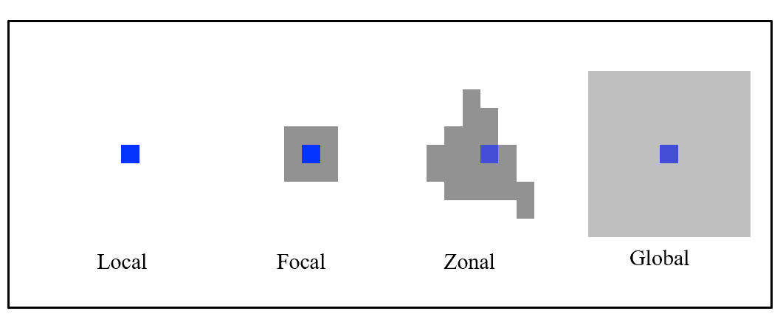
Spatial Scope (空間範圍) of Map Algebra Operations/Analysis
Notes:
Source: GEOG 187 Fall 2015 Lecture 06 Slide 24

Slide 16
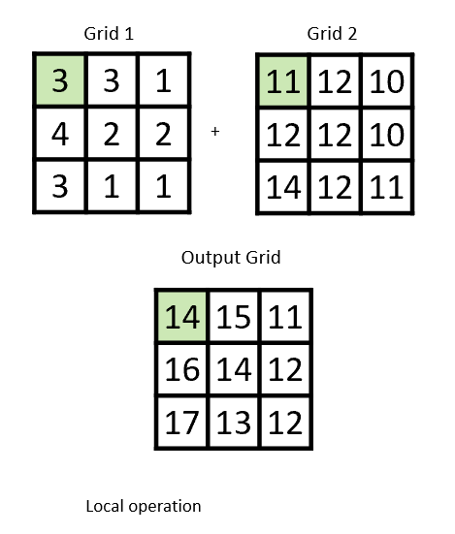
Local Operations 本土操作
Examine the raster cell-by-cell (逐格處理)
Compare a cell in one layer to the same cell in another layer
Notes:
Source: GEOG 187 Fall 2015 Lecture 06 Slide 26

Slide 17

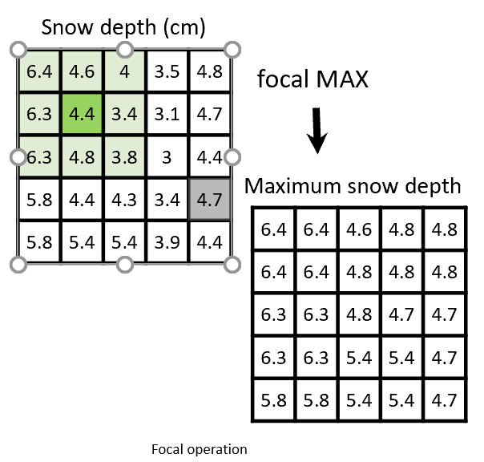
Focal Operations 焦點操作
Compares the value of each cell with the neighbouring cells
To calculate neighbour statistics
Can specify a window size (e.g. 3x3) for comparison
e.g. calculate max, min, average
Notes:
Source: GEOG 187 Fall 2015 Lecture 06 Slide 27

Slide 18

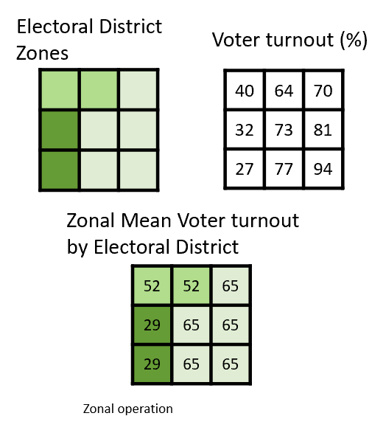
Zonal Operations 區域操作
Map zones are defined using common values and operations
e.g. calculate the average voting rate in an electoral district (選區)
Notes:
Source: GEOG 187 Fall 2015 Lecture 06 Slide 29

Slide 19
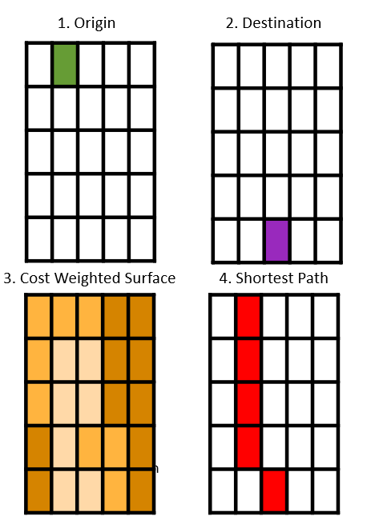
Global Operations 全域操作
Generate results that depend on all cells in the raster grid
E.g. Finding the shortest path between two points within a raster, finding suitable land for building a ski resort
Notes:
Source: GEOG 187 Fall 2015 Lecture 06 Slide 30

Slide 20
Learn about raster data in these courses…
GIS courses
GEOG 187 – Geospatial Data Science
GEOG 281 – Introduction to G.I.S.
Remote sensing courses
GEOG 271 – Earth/Space Remote Sensing
GEOG 371 – Advanced Remote Sensing Technology
GEOG 471 – Remote Sensing Project

Slide 21
Questions?

Slide 22
3. Tutorial
It’s your turn!
Now go to here to try out a raster layer: https://www.naturalearthdata.com/downloads/10m-raster-data/10m-natural-earth-1/
Load the raster layer into QGIS and view the properties.

